Slide 1

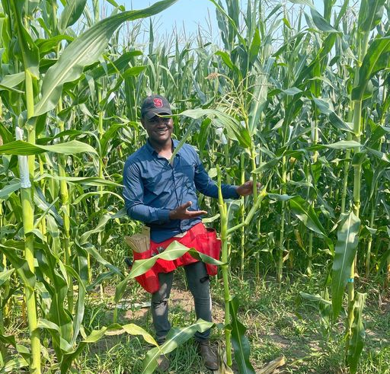
Discovering STEM in ACES Program (DSAP)
Mentor: Chris Mujjabi

Slide 2
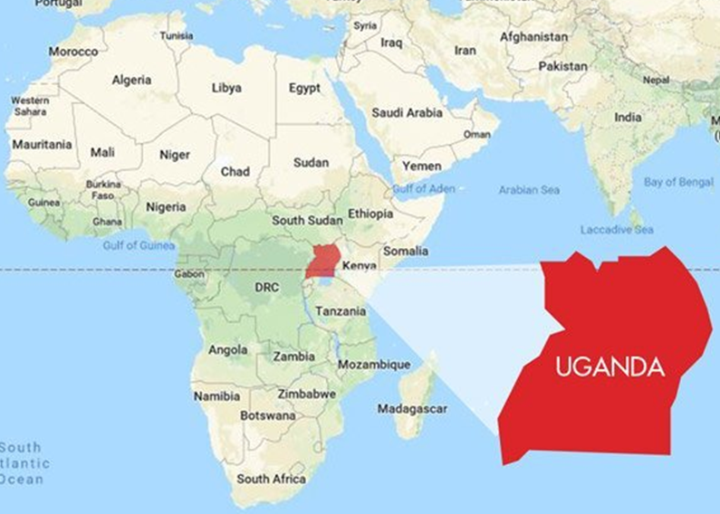
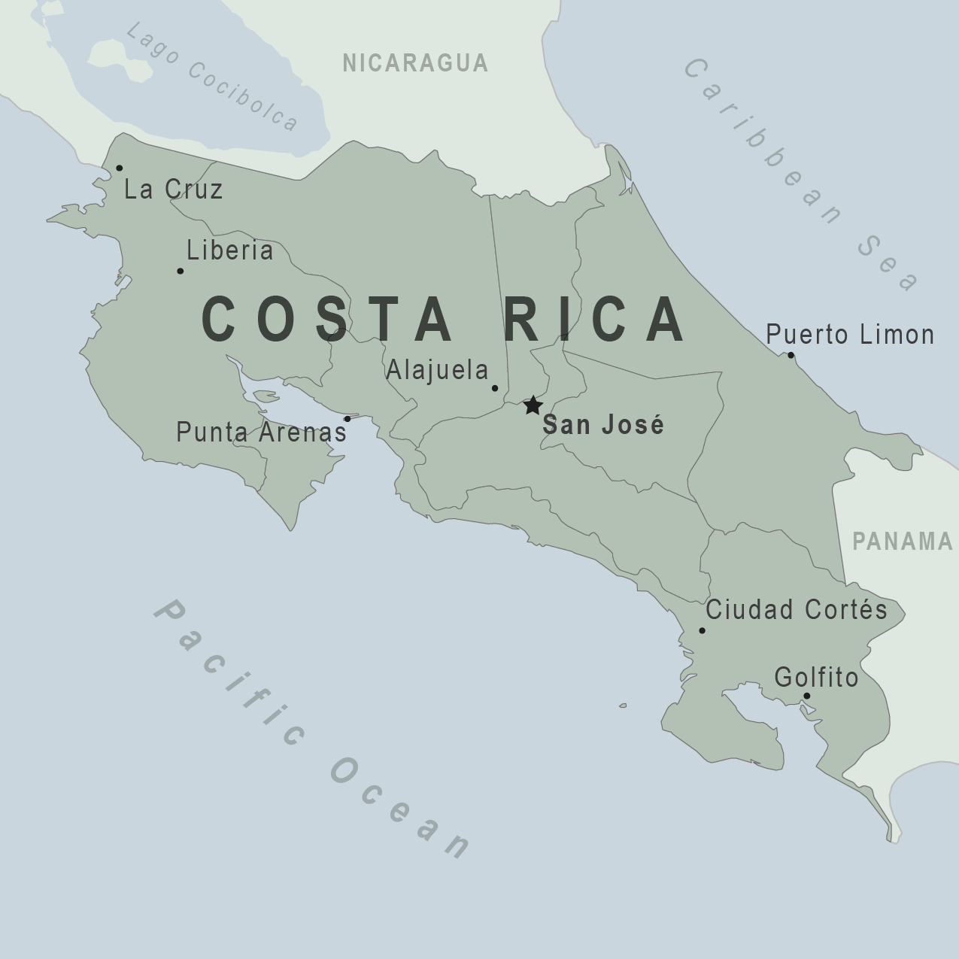
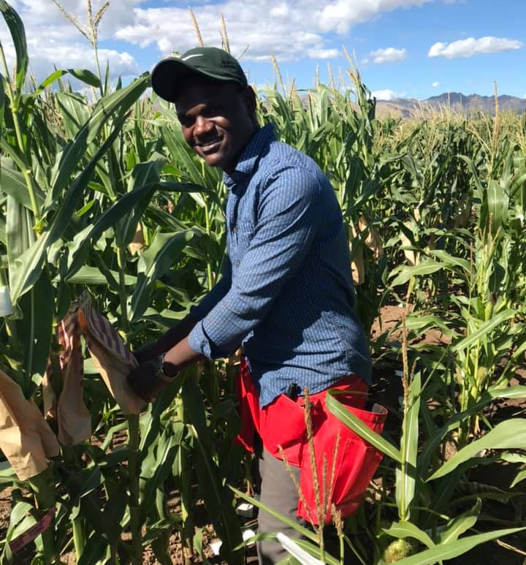


Born in Uganda
Undergraduate in Costa Rica
Bachelor degree in Agronomy
UIUC since 2018
Graduate Student
Research Assistant – Bohn Lab

Slide 3

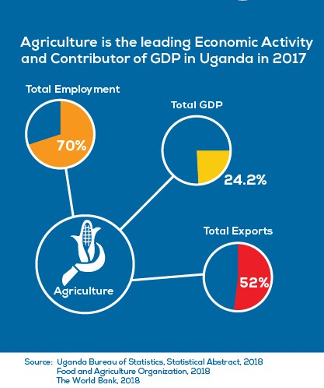
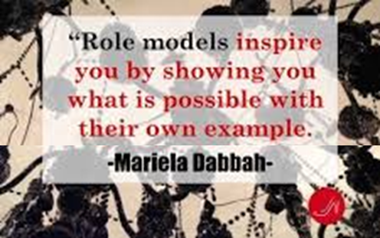
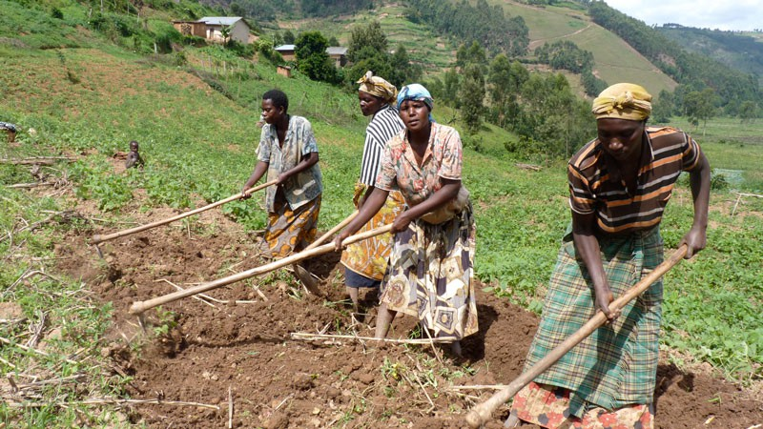
Importance of DSAP
Mostly subsistence farming
Highest percentage of farmers are women
“Peasant farmers” with hoes
Exploring the different carriers in Agriculture

Slide 4
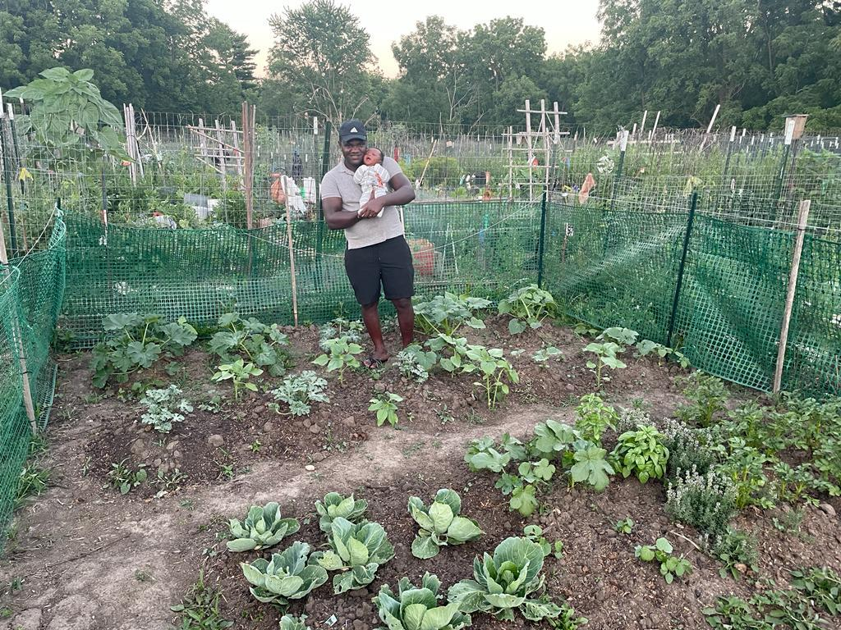

Slide 5
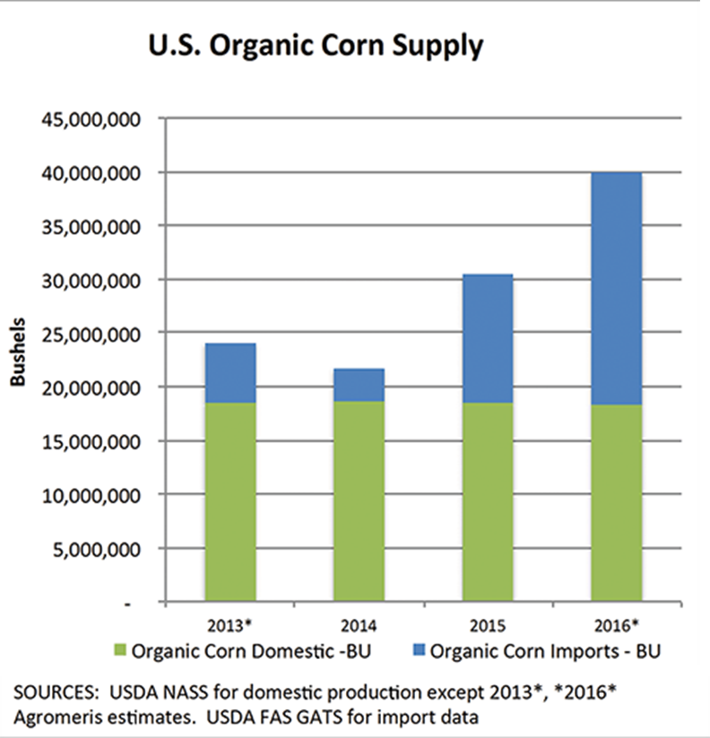
Breeding maize for organic systems.
Demand for organic products has surpassed domestic supply
Increased importation of organic products including corn
Farmers use conventionally bred varieties
Poor performing under organic systems
(Midwest Organic & Sustainable Education Service, 2017)

Slide 6
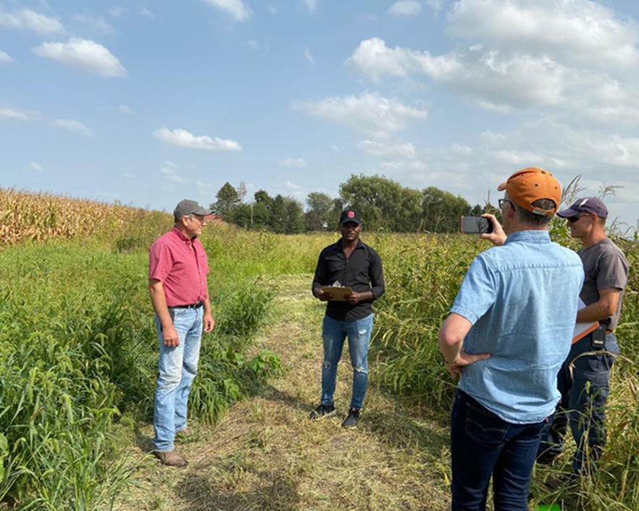
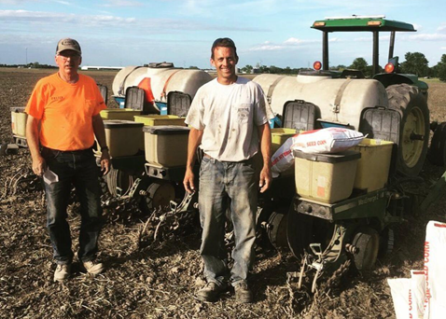
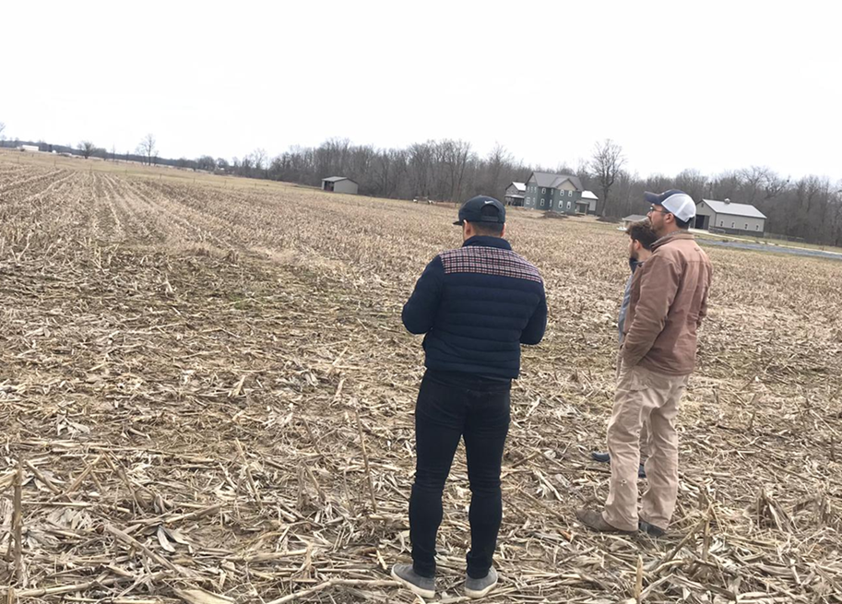
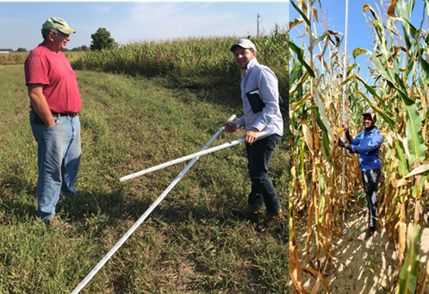
Participatory Breeding with a Variety Testing Network of Organic growers (2018 – 2021)
Organic farmers in IL, IN & WI
Evaluated performance of our germplasm under organic conditions
Identified traits of interest for organic farmers (weed pressure tolerance, grain quality, nutrient use-efficiency etc)
Baseline for new project focused on speed breeding for organics.
Use of winter-nurseries
Doubled haploids
Genomic prediction

Slide 7
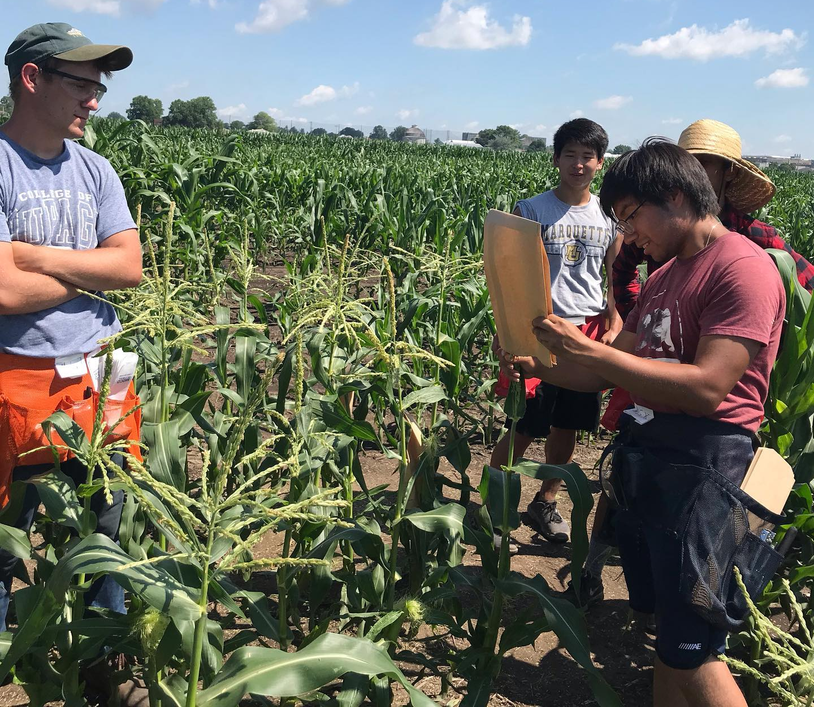
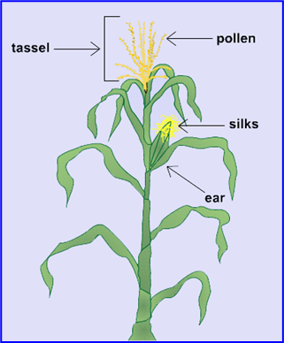
Maize Pollination for seed production
Learn the morphology of a maize plant
Cross pollination
Self Pollination
Difference between inbred and hybrids etc
Note: Practice in conventional nursery

Slide 8
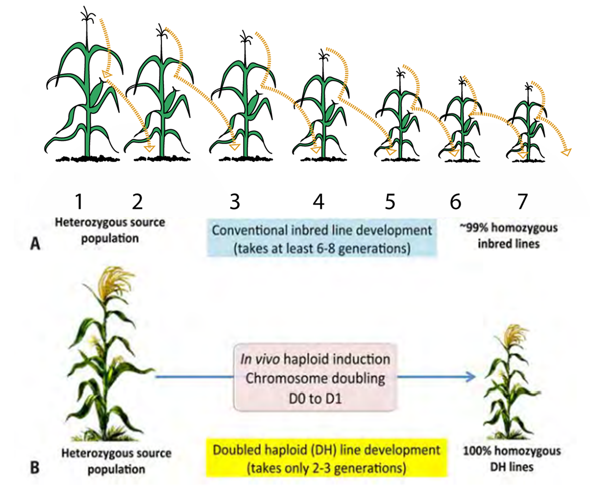
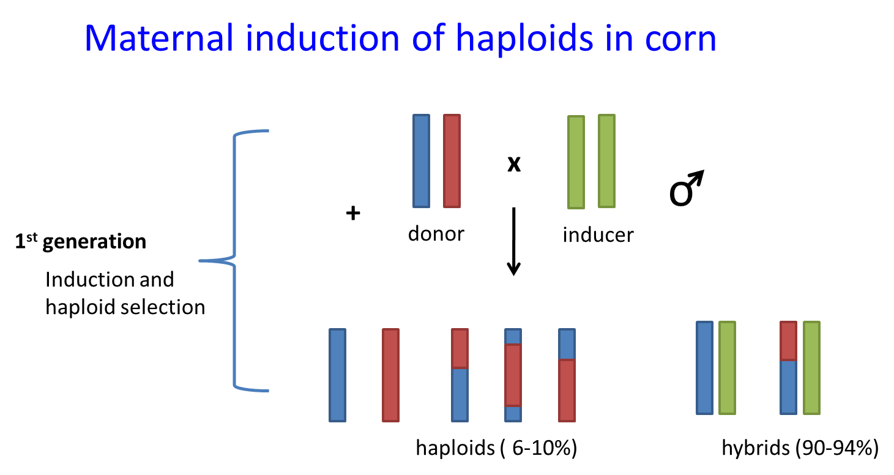
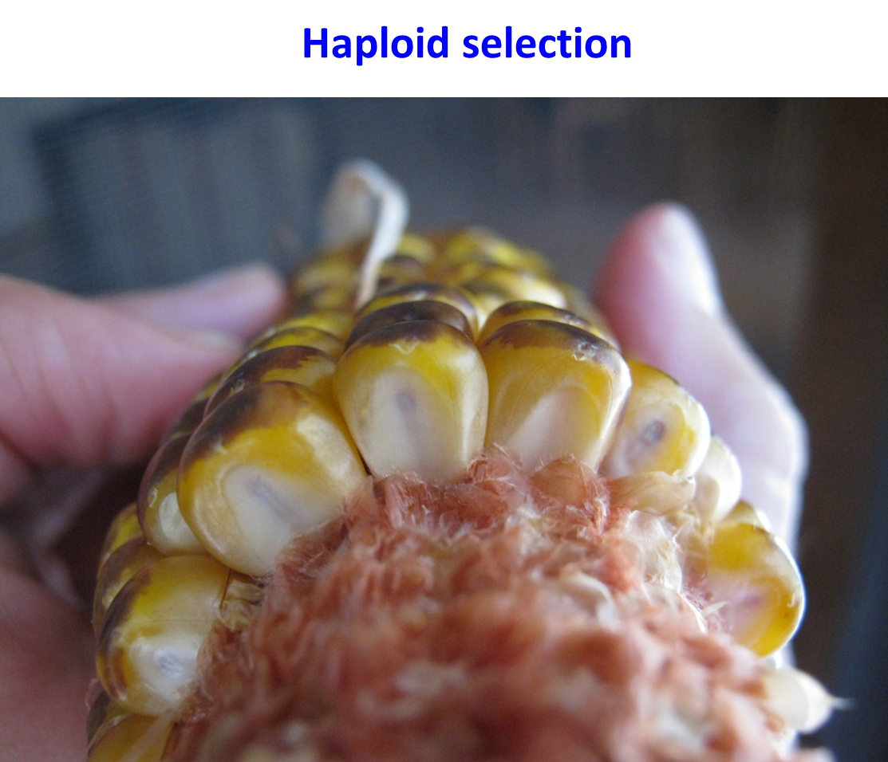
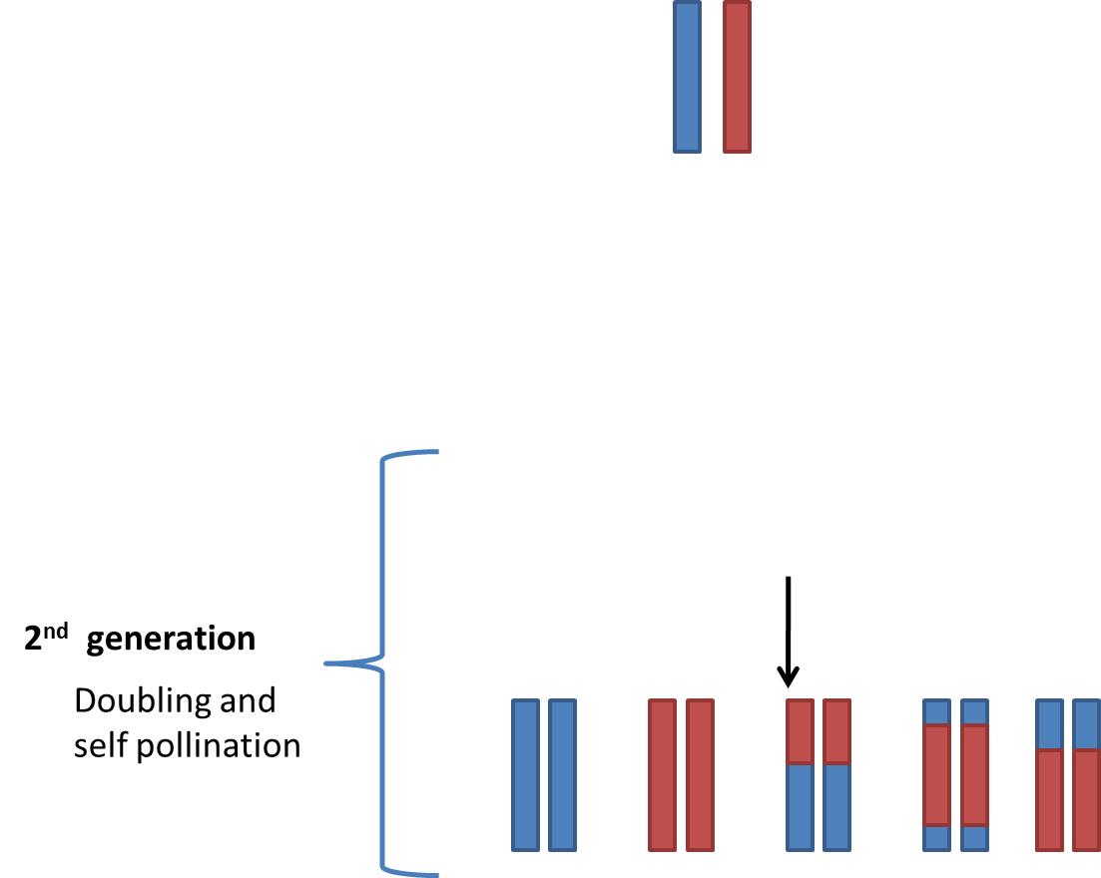
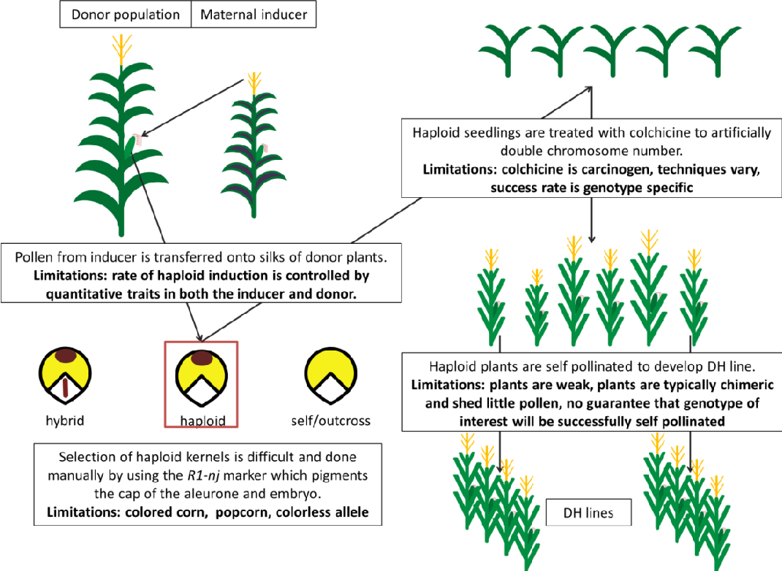
Introduction to Doubled haploid technique in corn breeding (Speed Breeding)

Slide 9
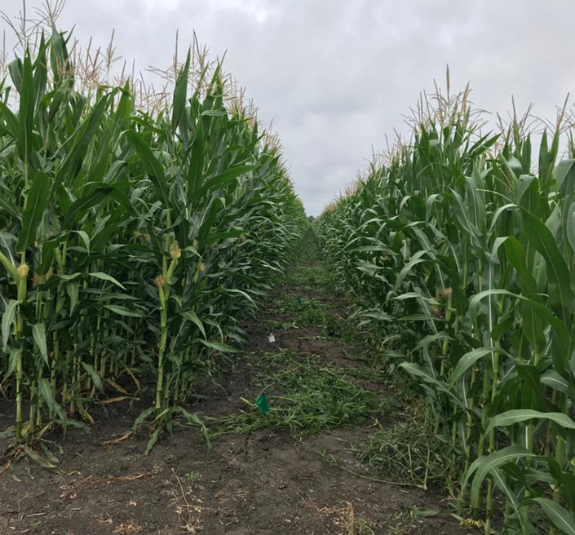
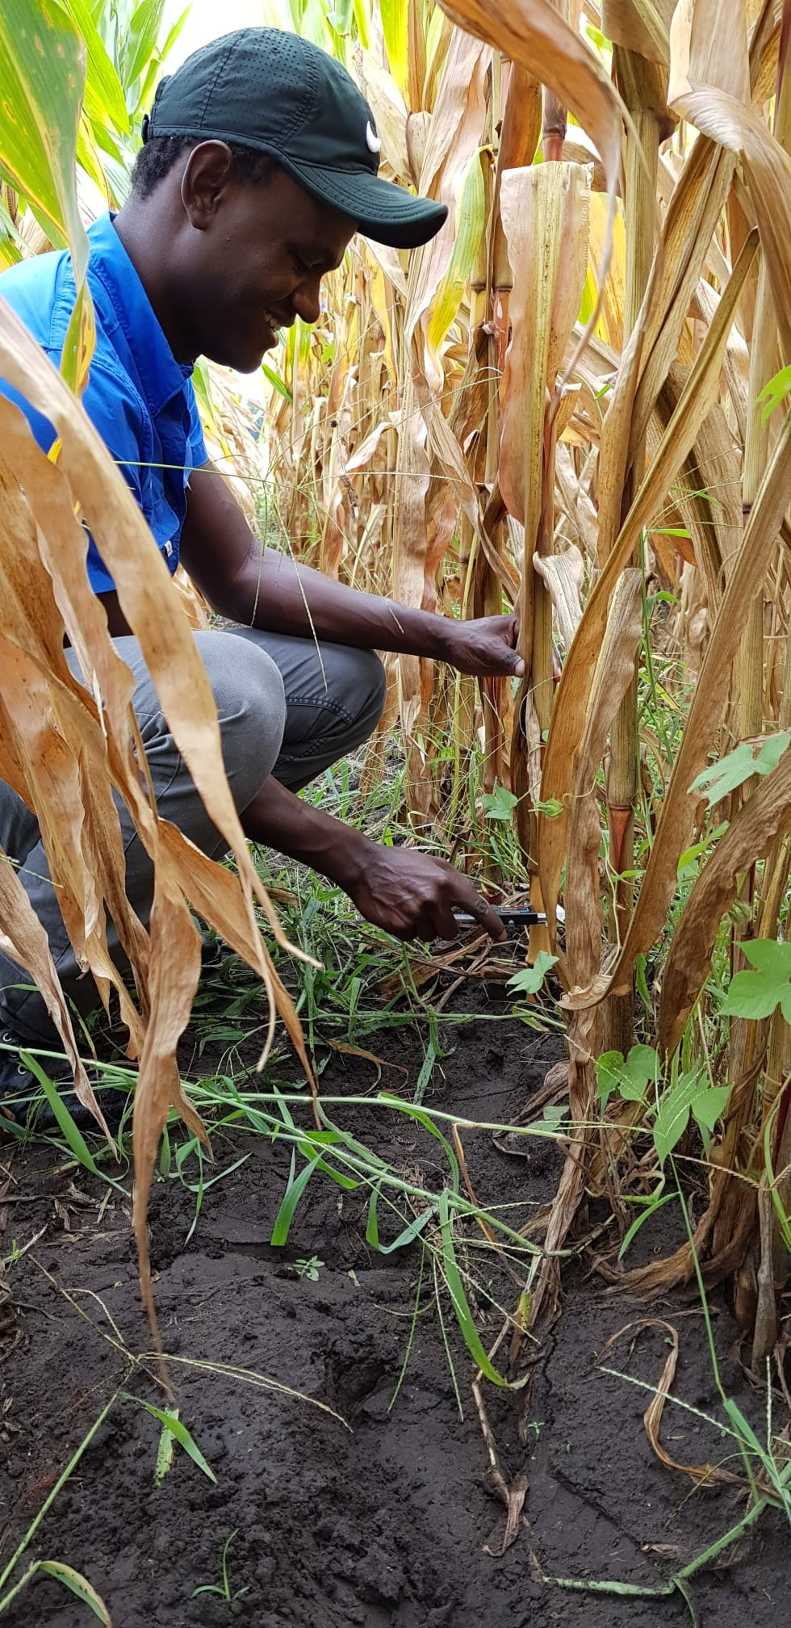
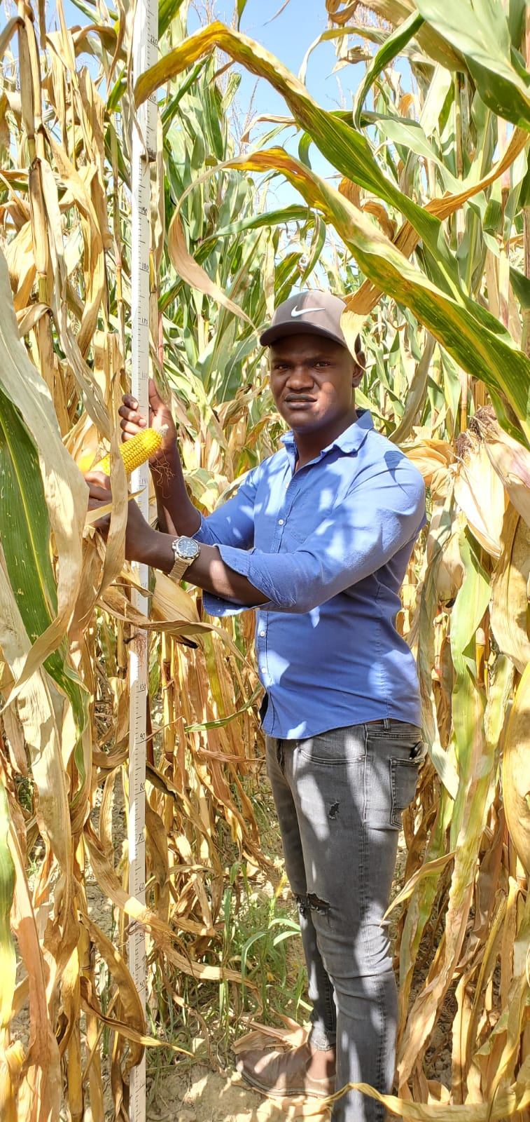
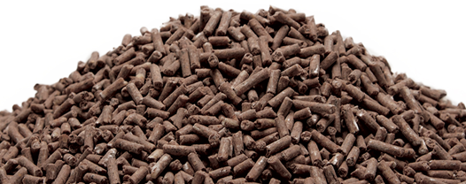
Phenotyping and Trait Evaluation (Data Collection)
Characterize phenotypic response of maize hybrids under varying crop rotation systems and soil nitrogen levels.
Nitrogen use efficiency

Slide 10

Introduction to Statistical Analysis and Hypothesis Testing
Use R Software to conduct a statistical analysis of the phenotypic data collected in the previous session
Test if N treatment influences hybrid performance. (Hypothesis testing)
Generate visual representation of our data (graphs, charts and figures in R)

Slide 11
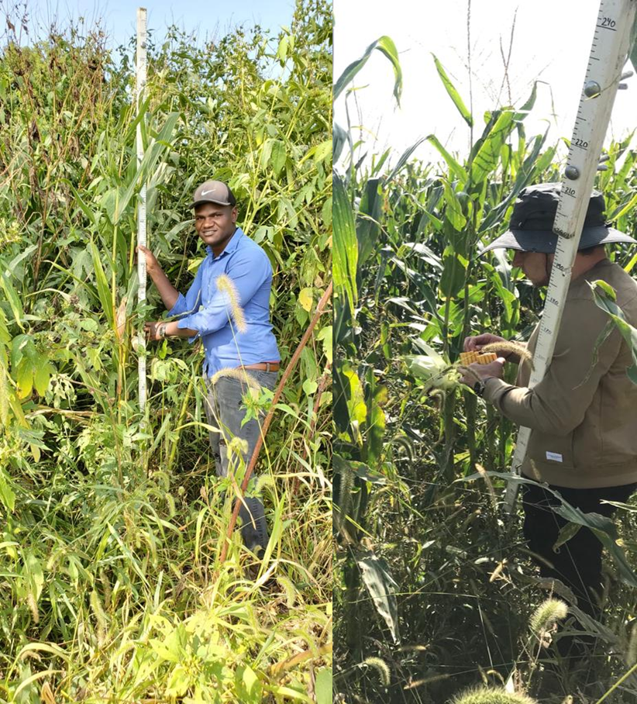
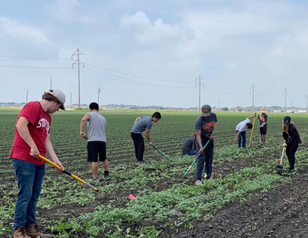
Weed management in Organic Systems

Slide 12

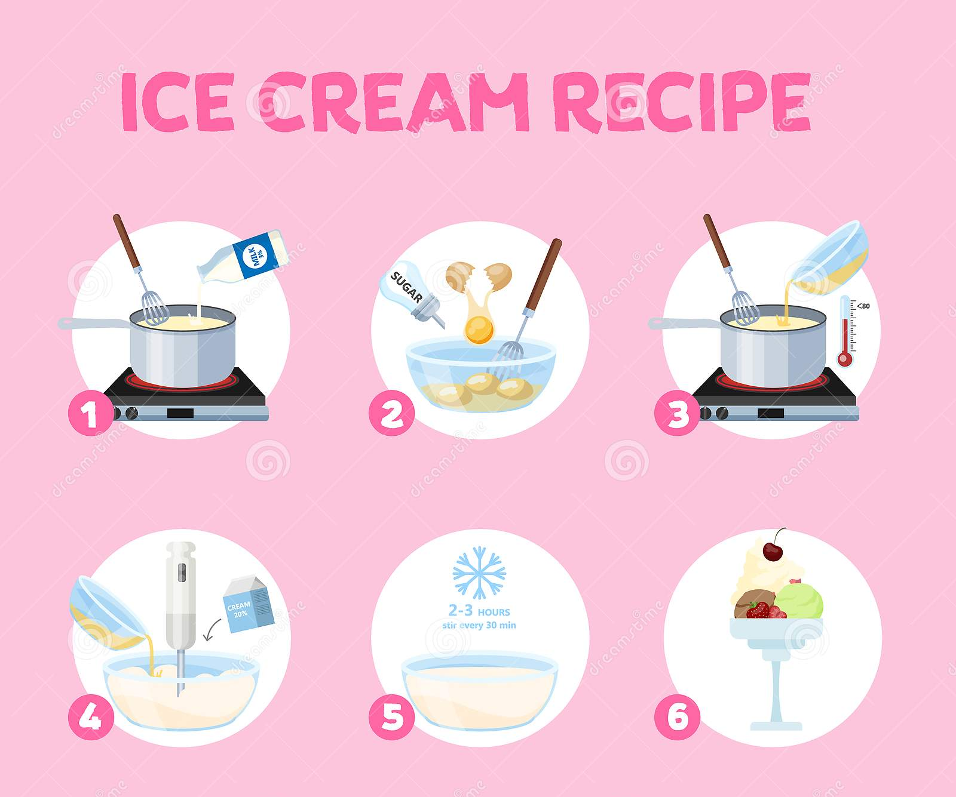
Additional Sessions
Undergraduate student panel
Ice cream experiment

Slide 13
Friday Afternoon:
Working on the presentations
Feed feedback from students
Answer any pending questions

